Slide 1



Reminder: Intersect with Speakers and Attendees
Tweet tips and tricks that you learn and follow tweets posted by your peers!
Follow: #SQLintersection and/or #DEVintersection
Join us – Wednesday Evening – for SQLafterDark
Doors open at 7:00 pm
Trivia game starts at 7:30 pm
Winning team receives something fun!
Raffle at the end of the night
Lots of great items to win including a seat in a five-day SQLskills Immersion Event!
The first round of drinks is sponsored by SentryOne and SQLskills
&

Slide 2

SQLintersection Session: Tuesday, 2:15-3:15PM Azure SQL Database: Maximizing Cloud Performance and Availability
Anna Hoffman (Thomas)
Data & Applied Scientist
antho@microsoft.com
twitter: @AnalyticAnna
Adapted with help from Joe Sack and Denzil Ribeiro
Notes:
Thanks for joining today. This session is about how you can take what you already know about performance and availability, and apply it to your databases in Azure SQL. Additionally, we’ll share a few insights on how you can easily become the expert on perf and availability for Azure SQL.
Now we’re combining these two topics together because the conjunction between performance and availability is very important.

Slide 3
Objectives
Make optimal choices for performance and availability in Azure SQL Database
Map your SQL Server performance tuning skills to Azure SQL Database
Recognize real-world troubleshooting patterns
Notes:
So today we’ll cover three main areas, and these areas are really woven together so you won’t see a clear break between the sections necessarily. We’ve kind of separated these ideas out but they aren’t isolated and sequential.
We want to start by making sure you understand the intelligent database, intelligent cloud that exists for you in Azure. One of the great things about moving to Azure SQL is that you can just set it and forget it in the cloud. However, there are optimal choices that you can make so you increase the odds that you don’t have to worry about it, and you decrease your costs.
Let’s start with a poll. How many of you would say you are already an experienced perf and tuning professional? Great. So all of you are about an inch away from being the experts for performance skills in Azure SQL.
The last aspect, recognizing real world troubleshooting patterns, is based on observations from what we’ve seen as a team on the Azure SQL product team. So, when you have issues, you typically (hopefully) open up a case with CSS. More often than not, they are able to help. If they can’t get to the bottom of it, then they escalate to the engineering team. Our team always has to have a certain number of engineers on call to manage cases that get escalated. What we’ve done today, is pick some of the themes we see and some tips we have around the mitigation and overall productive handling of it.

Slide 4
First principles
Notes:
So we’ll start today with first principles. Now, if we think about the SQL Server box world. You could learn things when the new version came out, for example when 2005 came out, you learned what was new, you figured out how to work well, and then you knew that would stay the case for the next 1-4 years.
Well, it’s not like that anymore. In Azure, we change things all the time, and so do our competitors. So, we want to start by laying some ground work around where we are today, so we’re all speaking the same language.

Slide 5
Why Azure SQL Database?
Automatic backups
Advanced security, threat detection, TDE by default
Ease of HADR (readable secondaries, geo-replication)
Familiar SQL Server ecosystem and mindshare
Latest code base and features
Automatic patching, upgrades
Quickly provision up or down
Query store on by default
Notes:
So, we’ll start with, why are customers coming to Azure SQL database?
It’s a very familiar product, as given by this conference, the many other SQL conferences, and the great community that we have today. Typically, we don’t want to learn something entirely new, but we want to use what we already know and get additional platform benefits. And that’s what Azure SQL does for us.
So what are some of those benefits? Well, you can scale and prepare for big events, for example Black Friday. You can address this easily, you could even rescale every hour. But preparing and allowing for this on premises is something that is a very different story today.
You also get things like automatic backups. Now, this isn’t necessarily the most interesting thing, but we do it automatically and you don’t ever have to worry about it.
Ease of HADR is another example. Now, here, a lot of you may be able to set this up in your sleep. But many customers don’t want to be in the business of doing this. With Azure SQL, you can set it up in less than an hour. Then, we’ll handle it, give you an SLA, and you don’t really have to worry about setting up the topology and infrastructure.
Security is also a big one. For example, we set up TDE by default. And with Advanced Data Security, you can get additional things like Advanced Threat Detection Alerts, and Vulnerability Assessment scans.
You also get the latest code base. For example, SQL Server 2019 became generally available recently. However, many of the features released there, were introduced into Azure SQL Database a while ago. We are now running at compatibility 150. We’ll flow in new features over time and you don’t have to worry about it. Making sure you don’t break and only get benefits becomes our responsibility. You also no longer have to worry about patching, upgrading, or worrying about patching and upgrading.

Slide 6



Azure SQL
SQL virtual machines
Managed instances
Databases
OS and SQL Server
“Managed” SQL Server
Just the database
Notes:
So let’s talk about the Azure SQL landscape today. The way I recommend thinking about it, is what scope do you want? If you want the OS and the instance, Azure SQL in a virtual machine will likely be best. Managed instances are best for lift and shit migrations to the cloud where you don’t need access to the OS, but you still need instance-level features like CLR, Service Broker, SQL Server Agent, etc. Finally, databases are if you just want a database, and for us to take care of the rest. Here we also have options for Hyperscale, which is basically limitless database size, and serverless, which allows for things like pausing your database and only paying for storage.
Today, we’re going to focused on the more managed side. So we will not be talking about SQL virtual machines, but there is a lot of information available in the documentation around how we can help you increase your performance and availability.

Slide 7


Azure SQL
SQL virtual machines
Managed instances
Databases
Best for migrations and applications requiring OS-level access
Best for most lift-and-shift migrations to the cloud
Best for modern cloud applications. Hyperscale and serverless options are available
SQL virtual machine
Single instance
Instance pool
Single database
Elastic pool
SQL Server and OS server access
Expansive SQL And OS version support
Automated manageability features for SQL Server
SQL Server surface area (vast majority)
Native virtual network support
Fully managed service
Pre-provision compute resources for migration
Enables cost-efficient migration.
Ability to host smaller instances (2Vcore)
Currently in public preview
Hyperscale storage (up to 100TB)
Serverless compute
Fully managed service
Resource sharing between multiple databases to price optimize
Simplified performance management for multiple databases
Fully managed service
Notes:
So let’s talk about the Azure SQL landscape today. The way I recommend thinking about it, is what scope do you want? If you want the OS and the instance, Azure SQL in a virtual machine will likely be best. Managed instances are best for lift and shit migrations to the cloud where you don’t need access to the OS, but you still need instance-level features like CLR, Service Broker, SQL Server Agent, etc. Finally, databases are if you just want a database, and for us to take care of the rest. Here we also have options for Hyperscale, which is basically limitless database size, and serverless, which allows for things like pausing your database and only paying for storage.
Today, we’re going to focused on the more managed side. So we will not be talking about SQL virtual machines, but there is a lot of information available in the documentation around how we can help you increase your performance and availability.

Slide 8
DTU-based purchasing option and service tiers
Choose a blend of compute, memory, and I/O resources to support light to heavy database workloads
Basic for less demanding workloads
Standard for workloads with a range of performance requirements
Premium for IO-intensive workloads
Notes:
Now, once you select a deployment option, you have different purchasing options and service tiers that you can choose from. This isn’t meant to make things more complicated for you. Instead, we want to give you the flexibility to get exactly what you need.
The first purchasing option, that’s shown here, is called a DTU. This basically means, don’t tell me what it is, but just give me a blend of compute, memory, and I/O so I can support my workloads. Now this abstraction works for some customers, but other customers have specific patterns and they may want more granularity into their selections.

Slide 9
vCore purchasing option and service tiers
Choose the number of vCores, compute generation, storage size
General Purpose for budget oriented balanced compute and storage
Business Critical for high transaction rate and low IO latency. Fast failovers using multiple replicas. Free-of-charge read-only replica. RPO 5 sec, RTO 30 sec.
Hyperscale for auto-scaling storage size up to 100 TB, compute scaling and fast database restore.
Provisioned vs. Serverless
Notes:
So, a while after DTUs became a thing, we introduced vCores (virtual cores). We recommend, if you’re starting today, to start with General Purpose within the vCore model. Most of our customers are running in General Purpose and it’s just fine for their workloads. If you end up needing lower latency or a free read-only replica, you might consider using the Business Critical tier. Or, if you need more storage than allowed in Azure SQL, so 4 or 8 TB depending on which deployment option, then you can switch to Hyperscale as needed.

Slide 10
Demo
Serverless

Slide 11
Azure SQL: vCore Service Tiers
Service tier | General purpose |  | Business critical |  | Hyperscale
Best for | Most budget-oriented workloads |  | Critical business applications with high IO requirements. |  | OLTP and HTAP workloads with highly scalable storage and read-scale requirements
Deployment option | Single / Elastic Pools | Managed Instance | Single / Elastic Pools | Managed Instance | Single
Compute tiers | Gen4: 1 to 24 vCore Gen5: 2 to 80 vCore Serverless: 1 to 16 vCore | Gen4: 4 to 24 vCore Gen5: 4 to 80 vCore | Gen4: 1 to 24 vCore Gen5: 2 to 80 vCore | Gen4: 4 to 24 vCore Gen5: 4 to 80 vCore | Gen4: 1 to 24 vCore Gen5: 2 to 80 vCore
Storage | Remote SSD based Premium storage |  | Local SSD |  | Local SSD Cache, remote Page servers with local SSD ( RBPEX)
 | 32GB – 4TB per instance | 32GB – 8TB per instance | 32GB – 4TB per instance | 32GB – 4TB per instance | Scale from 10GB to 100TB of storage in 1GB increments
In-Memory | Not supported |  | Supported |  | Not supported
Read-write IO | 7000 IOPS 5-10ms for data access |  | 200K IOPS 1-2ms for all data access |  | RBPEX: 200K IOPS,1-2ms for hot data access Remote reads: >2ms
Log throughput | 1.875 MB/s per Vcore (Max 30MB/sec) |  | 6 MB/s per Vcore (Max 96MB/sec) |  | 100MBPS
Read Replicas | 0 read replicas |  | 3 replicas, 1 read-scale replica, zone-redundant HA |  | Primary read/write replica + up to 4 read replicas
Backups | RA-GRS, 7-35 days (7 days by default) |  | RA-GRS, 7-35 days (7 days by default) |  | LRS, ZRS, RA-GRS, 7 days
Notes:
Now, you’re not meant to consume this today. It’s a very busy visual. However, we want you to know that it exists, and you can find the full details and range of options, that are up to date, from here: https://docs.microsoft.com/en-us/azure/sql-database/sql-database-vcore-resource-limits-single-databases. This is more of a reference, that tells you what you get as you go from offering to offering, so just keep that in mind.

Slide 12
SQL Database price-performance leadership
Price-performance comparison¹
(Azure SQL Database BC_Gen5_80 vs SQL Server on AWS RDS db.r4.16xlarge)
License-included for both services
Azure (AHB + 3-yr RI) vs AWS RDS w/ 3-yr RI
40% saving
86% saving
Source: GigaOm
¹Price-performance claim based on data from a study commissioned by Microsoft and conducted by GigaOM in August 2019. The study compared price performance between a single, 80 vCore, Gen 5 Azure SQL Database on the business critical service tier and the db.r4.16xlarge offering for SQL Server on AWS RDS. Benchmark data is taken from a GigaOM Analytic Field Test derived from a recognized industry standard, TPC Benchmark™ E (TPC-E), and is based on a mixture of read-only and update intensive transactions that simulate activities found in complex OLTP application environments. Price-performance is calculated by GigaOm as the cost of running the cloud platform continuously for three years divided by transactions per second throughput. Prices are based on publicly available US pricing in East US for Azure SQL Database and US East (Ohio) for AWS RDS as of August 2019. Price-performance results are based upon the configurations detailed in the GigaOM Analytic Field Test. Actual results and prices may vary based on configuration and region.
Notes:
In terms of benchmarking, we’ve been pretty quiet over the last few years, and that’s because the TPC benchmarking wasn’t really built for the cloud. But we are starting to get into it. This study from GigaOm was released in October.
Now, another thing to note here from this study, is that nothing exactly matched. You can’t really compare apples to apples us with AWS, because there are slight differences among what’s available. One may offer more or less or slightly different.
One of the key things to point out here, is the additional cost savings you can get from a licensing perspective if you use Azure SQL. If you have licenses on-prem, you can use those, in addition to things like prepaying for reserved capacity, to save a ton on Azure SQL database. So those acronyms are AHB (Azure Hybrid Benefit) and RI (Reserved instances).

Slide 13
Azure SQL Database Availability SLAs
Highest availability SLA in the industry, leveraging availability zones
Differentiated SLA for Hyperscale based on # of replicas
Only business continuity SLA in the industry, RTO & RPO, 100% service credit
Database uptime in a region + guaranteed recovery during disasters = mission critical fault resilience
SLA category |  | service tier | sla | Maximum service credit
Availability |  | Hyperscale w/ 0 replicas | 99.9% uptime | 100%
 |  | Hyperscale w/ 1 replica | 99.95% uptime | 100%
 |  | Hyperscale w/ 2+ replica | 99.99% uptime | 100%
 |  | General purpose | 99.99% uptime | 100%
 |  | Business critical (zone redundant) | 99.995% uptime | 100%
Business continuity | Recovery point objective (RPO) | All | 5 sec | 100%
 | Recovery Time Objective (RTO) | Single database | 30 sec | 100%
For more info see https://azure.microsoft.com/en-us/blog/understanding-and-leveraging-azure-sql-database-sla/
Notes:
OK one last layer now is SLAs. We’re almost past the basics here. We have really great SLAs, and we recently even added SLAs for RTO and RPO. Hopefully, you all know the difference between RTO and RPO. Anyone care to explain?
RPO stands for recovery POINT objective, i.e., how much data is one potentially prepared and willing to lose, worst case
RTO stands for recovery TIME objective, i.e., if/when the ‘bad thing’ happens, how much time does it take to be back up and running again
Why are we talking about SLAs? Out of the gate, we want to make sure we keep you running. This means that anyone can go and set this up and get great performance by default. And, at the time of this presentation, we are the only folks to have a BCDR type of SLA.
[should be about 15 minutes in]

Slide 14
Performance tuning in Azure SQL DB
Notes:
Now, before we go any further, I have a question.
How many are not in cloud today?
How many are in Azure SQL DB today?

Slide 15
First decisions: initial sizing
Initially choose based on existing resources used on-prem
You can scale up or down accordingly
Whenever possible, test ahead of time using representative workloads and data distributions
Stay at your current database compatibility level until you are ready – we will support you
As you would in SQL Server, use a performance monitoring and tuning methodology to assess resource utilization vs. headroom
Notes:
So what we’ve found is that there are patterns around initial sizing. Whatever you do today on-prem or somewhere else, keep it similar when you move. Go with less, and then you can adjust as needed. And, you might think that that’s weird advice coming from Microsoft. But we want you to be right-sized so that you get the full cost benefit of moving, and so that you stay.
When you have the opportunity, please test your performance ahead of time. We’ve had customers, big customers at that, that decided they’d take their highest, most important workloads, and just move them. And then it’s a really big deal, with a lot of issues. It’s stressful. You don’t want that. We don’t want that. Nobody wins. Make sure you do testing. And we know it’s not always so easy to get a good test workload, but it really is important, so make sure you invest the time to do so. We have a tool within the Data Migration Assistant, that can analyze your workload and make recommendations, it’s called the SKU Recommender: https://docs.microsoft.com/en-us/sql/dma/dma-sku-recommend-sql-db?view=sql-server-ver15.
Now that SQL Server 2019 has launched, we will start rolling out the dbcompat of 150 as the default. But, we won’t update you if you’re on, say, 110. You can choose to update if you want, or you can stay at 110, just as you would do with your SQL Server machines on prem today. With finite memory, finite IO, etc., you need to use the performance monitoring and tuning methodology just as you would on-prem to assess things like resource utilization versus headroom. And that’s what we’ll talk more about today.

Slide 16
Performance tuning in the cloud
Some things are the same – and some are different but not difficult to pick up
A few SQL DB-specific factors:
All tiers have necessary limits to achieve the balance between perf and availability (Single DB Limits and Elastic Pool Limits).
Full recovery model
Business Critical has HADR replicas
Notes:
OK so there are some things that are the same, but there are also some things that are different. A few examples: we run in full recovery mode, so if you move from simple recovery to Azure SQL, you’ll see some changes due to that. We also have replicas running, depending on what you set up, so that can be a factor.

Slide 17
Tools
Query Store
Identify top resource consuming queries
Identify top waits and regressions.
DMVs, Extended Events
Similar experience and benefits as you’ll find in SQL Server
Azure SQL Analytics
Cloud monitoring across single, pooled, and Managed instance databases
Intelligent Insights
Detects performance bottlenecks and patterns
Database Advisor
Index recommendations
Ability to apply recommendations and monitor
SQL Database automatic tuning
Monitors queries, applies recommendations
Monitors regressions, self correction (FORCE_LAST_GOOD_PLAN)
Notes:
From a tooling perspective, most of these should be pretty familiar to you all, so I won’t spend a lot of time here. I’ll share the resources for where this deck is, so you can look into these later. There are a few others that you might not be familiar with. For example, Azure SQL Analytics, which isn’t exactly built in, you just have to configure from the Azure Marketplace and say that you want it.

Slide 18




Other monitoring options
Third party tools
Query performance insight library
Near-realtime monitoring for Azure SQL using OSS telegraf
Can monitor Managed instances, Azure SQL DB, On-premises SQL Server
Monitoring VM
Telegraf
Telegraf
Browser
Notes:
There are other third-party tools as well, which you’ll have access to. One example is a set of scripts developed by Jovan Popavic, who is a Program Manager on the Managed instance team. We’ll take a peek at some of these that you can use in the demos.
~20 minutes in

Slide 19
Performance tuning in Azure SQL DB
Sys.dm_db_resource_stats
Portal/Powershell/Alerts
Sys.dm_db_wait_stats , sys.dm_exec_requests
Query Store!
Check Resource consumption
Running (CPU)?
Waiting
IO Latch
Lock Waits
Latch Waits
… Others
Execution
Compilation
Memory Grants
Tempdb
Query Store
dm_exec_query_stats, dm_exec_procedure_stats
Notes:
Alright, so let’s say I get woken up at 2AM for some sort of performance issue in Azure SQL Database. Investigating and checking it out is very similar to on-prem. First, we’ll check the resource consumption right, and if there are issues here I want to start there. So I can check sys.dm_db_resource_stats using the Azure Portal, PowerShell or alerts that we might have set up.
Next, we might check if we are running CPU hot. And if I am, for example let’s say I’m running like 90% over time, I might check, is it execution or compilation overhead? Now we can start to use all our on-prem skills. We can leverage things like the Query Store, dm_exec_query_stats, dm_exec_procedure_stats…
Now, if we aren’t running hot on CPUs and it was pretty clear it wasn’t compilation or execution, then you can look at wait statistics. We’ll try to find what’s waiting, and we do this the same way that you’d do it on-prem. Leveraging the query store, there are actually certain waits that get stored there too.
So the only big difference is checking that resource consumption.

Slide 20
Data loading tips
SQLDB is Full recovery model
On Heaps still use TABLOCK (#locks acquired)
On Columnstore tables batch size > 102,400
Partitioning very large tables is important
Flexibility on smaller index rebuilds.
Load into staging table
Build aligned indexes
Switch into partitioned table.
Load data in parallel improves throughput
Lower #parallel loads on Columnstore due to memory grants.
Use compute (ADF/ Spark) offloads the “read” of the files to a compute engine rather than SQL DB.
For large data warehouse loads (>100MB/sec), consider Azure SQL DW.
Notes:
OK let’s go through a few other data loading tips. This was briefly mentioned earlier, but don’t baseline against simple recovery model, because in Azure SQL, we require full recovery model. Things like TABLOCK can help (minimizes the number of log records for the insert operation https://docs.microsoft.com/en-us/sql/t-sql/queries/hints-transact-sql-table?view=sql-server-ver15 ). You can also use columnstore for large tables and aggregate types of operations. This will help again with generating less into the log.
Partitioning is very important and something that’s less used among customers. Additionally, loading in parallel is very important for increasing throughput. You shouldn’t do parallel as you would in a heap, because you could hit memory grants. We recommend you start with 4 and see if you’re hitting limits.
You can also leverage things like Azure Data Factory and Spark to offload and read the files. It can be faster and sometimes cheaper to do this than just using SQL DB. And if you have much larger loads, you may consider the data warehousing solution.

Slide 21
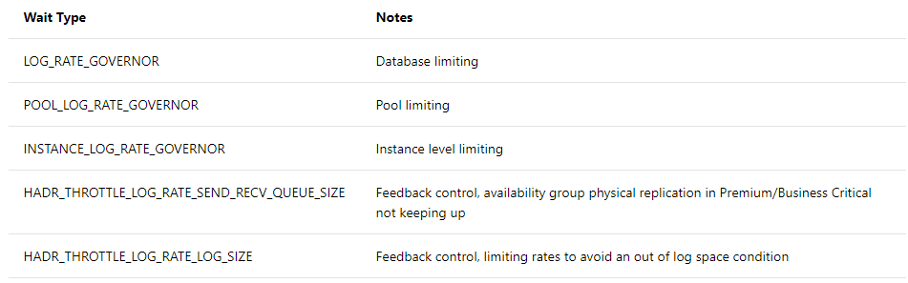
Log rate governance
Required for replicas to be in sync
Backups of transaction logs can sustain recoverability SLAs
Applied to Log generation itself not at storage layer
Surfaced as waits
Notes:
For log rate governance there are a couple of waits, not only the log rate governor. There are ones for pools and instances, as well as limits around HADR. And you can choose to set up alerts depending on what waits are surfaced. Some options available if these arise and more explanations can be found here: https://docs.microsoft.com/en-us/azure/sql-database/sql-database-resource-limits-database-server#transaction-log-rate-governance.

Slide 22
Demo
Governance limit data loading
Notes:
Alright, so let’s switch to a demo now. The first one we’ll look at is data loading in SQL DB. We talked about resource stats so I wanted to start here. You’ll be able to see a percentage of the cap, which is dependent on the service tier that you’ve chosen.
Things like sys.dm_user_db_resource_governance (https://docs.microsoft.com/en-us/sql/relational-databases/system-dynamic-management-views/sys-dm-user-db-resource-governor-azure-sql-database?view=azuresqldb-current) can help. This will give you the SLO, the memory, max database size, max log generation rate, etc. Some of those values are here.
So what we’ll do is create a table and start with a bulk loading scenario. I have to first provide a master key and point it to a storage account which has the files that we’ll be bulk loading. Then, I have to create an external data source. Only then can I start to do a bulk insert. I’ll also use tablock and batchsize to get the best performance. Now, I can switch over to the Telegraf and Grafana solution that can help, it gives this dashboard. I can see all this that is being pulled from the resource governance DMV.
So we can see load happening, and this is a single thread bulk inserting. We see one wait type IMPROV_IOWAIT, and that’s because we are bulk loading.
Note I didn’t hit the log generation rate, so I can go parallel on this. I can switch to a PowerShell script that will load four in parallel. If I look at sys.dm_exec_requests, I can look at some diagnostics.
You will see that I am getting the IMPROV_IOWAIT. But after some time we’ll see wait types that show we’re hitting the 30 mbps limit, log_rate_governor. I’ll start to get throttled by that tier. This is a new wait type that’s just in Azure. Back in the dashboard, I can see that I’ve flatlined at 30 mbps, and for waits I see the log_rate_governor. So we’ve been capped and I’m being throttled. What is the solution?
We can go up in service tier to alleviate the bottleneck that is happening here. We can see this took 1 min, 4 sec.
Now, I can choose to go to Business Critical or Hyperscale from here. Let’s say we switch to Hyperscale, which is kind of in between GP and BC in performance and cost.
Here, I’ll take 8 streams instead of 4, and we’ll run the same thing. I can confirm that there are 8 running in parallel. I shouldn’t see any wait types in the Grafana dashboard, because I have a max rate of 105 mbps. I see I have the IMPROV_IOWAIT because I’m still bulk loading, but I can get more log flush/second (show it has gone up), and no resource governance limits are hit.
About 25 minutes in
file:///C:/Users/antho/OneDrive%20-%20Microsoft/SQLTeam/demos/bulk_loading/bulk_loading.html

Slide 23
Networking general recommendations
Collocate App & SQL in same region
Use Accelerated Networking on App VM when possible
Networking tools : psping, Latte for Windows , Sockperf for Linux
If possible, batch data together
Using TVPs
Using Multi-row parameterized statements
Using SQLBulkCopy
Where applicable use SET NOCOUNT ON
Recent versions of drivers and tools are recommended
Notes:
So now let’s talk about some general networking recommendations. You want to collocate your application and SQL databases in the same region. You want to use accelerated networking from your App VM when possible, ideally in the same virtual network.
If you don’t need to make chatty applications, doing batch or bulk is going to be better
If SET NOCOUNT ON is applicable, it can greatly reduce the network traffic and increase performance (https://docs.microsoft.com/en-us/sql/t-sql/statements/set-nocount-transact-sql?view=sql-server-ver15).

Slide 24


SQL Database Connectivity Architecture
WEST US
23.99.34.75
GW
GW
mysqldbsrv.database.windows.net
104.42.238.205
GW
GW
westus1-a.control.database.windows.net
104.42.238.205,1433
GW
proxy (default)
(1) redirect-find-db
GW
GW
(2) redirect-query
..westus1-a.worker.database.windows.net
13.123.237.158, [11000 -11999]
Notes:
https://docs.microsoft.com/en-us/azure/sql-database/sql-database-connectivity-architecture
OK so we’ll switch gear slightly and talk about the perspective of a client connection. There are two main options for how you connect to SQL DB, Proxy or Redirect. These are server level settings and apply to all databases.
Let’s say we have a set of SQL DBs. When the client issues a connection, it goes primarily to the gateway which then routes to a backend connection, which is not visible to the client. This is proxy mode.
Then, there’s redirect mode in which the initial connection goes through the gateway, but then it returns the actual database connection. So everything after that goes directly to the database. Now, the tradeoff is that you have to open certain outbound ports for this to work 11000-11999, so this will depend on your organization’s policies. But, redirect is better from a performance standpoint.
5 minutes – about 30 min in

Slide 25
Demo
Proxy vs Redirect
Notes:
Let’s look at what type of impact this can actually have with a demo. I will look at an application here, it’s a low latency, very chatty application that is leveraging the 80 vCore tier. We can confirm the policy is proxy. One important note is that you can only change this via PowerShell or CLI. So the policy is set to proxy, and we’ll run our first set of tests with that. So I’ll start the workload.
Now, if we go to the dashboard to see what that looks like, we can see it’s 80 vCore. The Log rate and stuff doesn’t really matter. We can see that the batch requests is going up and it will level out around 80-85K. I’ll also make a new connection and include client statistics so we can see the roundtrip latency. I’ll initialize a variable and go 1000 times. It takes about 1 second, and that’s really just network traffic.
Now, I can change it to redirect mode with PowerShell and restart the same application. Looking at the dashboard, we can see we’re able to go way over 100K and it will level out around 125K. Note that we didn’t change anything except the connection mode. Now we create a new connection and see how round trip changes, and it’s about half a second. So this is what happens when you don’t have to go to the gateway at each step.
Question from audience – why would I use proxy? Depends on your policy sometimes you cant open that outbound port
Could the port be different? Will the sql server ip and port be different? You’re still connecting to the name, so you still go initially through the gateway, the driver takes care of the rest
The gateway is going through SQL DB infrastructure in azure
Theres a default setting, if the VM for e.g. is on Azure, you can use redirect. But if you block 1433 outbound you cant use redirect
Question - I have an on prem app do I have to open ports? For vm? For both yes. Default for VM is allow all outbound ports
Vnet rules will determine if you can use redirect
From security aspect, I shouldn’t open any outbound ports, how can I use this? You can’t. it’s a tradeoff.
So redirect is better if you can
About 35 min in

Slide 26
Storage
Size | P10 | P20 | P30
Disk Size | 128 | 510 | 1024
IOPS | 500 | 2300 | 5000
Throughput | 100 MB/s | 150MB/s | 200 MB/s
Local storage
General Purpose: used for tempdb only
Business Critical: used for all database files
Hyperscale: used for tempdb and local RBPEX
Remote storage
Database files are page blobs in Azure Premium Storage
IOPS/throughput is tied to blob size
5-10 ms latency, unless throttled
Blob size >= database file size
MI storage limit is based on file size, not blob size
2 TB
1.1 TB
data file 1
data blob 1
data file 2
data blob 2
data file 3
data blob 3
data file 4
data blob 4
transaction log file
transaction log blob
Database file size: 5.5 TB
Database blob size: 10 TB
Premium storage limits
Notes:
Let’s move on and talk about storage. Local storage (directly attached SSDs or MVMEs) is used for your SQL database depending on the service tier. With GP, it’s only for tempdb, for BC, it’s used for all your database files, and for Hyperscale, it’s used for tempdb and local RBPEX.
There’s also remote storage, which is remote and not local. The IOPS there are tied to a blob storage size, so if you have a P10 size the IOPS limits are the same. There are different limits but you can read exactly what they are like throughput limits, so the blob size really matters. We’ll see a demo of how that can change things.
There are a couple of new functions that can help you expose the blob tiers. So for example, if I see I’m using P10 premium blob storage, my database will inherit some of the properties of that storage tier, the IOPS is 500 and the throughput is 100 mbps.

Slide 27
Storage
Local storage
General Purpose: used for tempdb only
Business Critical: used for all database files
Hyperscale: used for tempdb and local RBPEX
Remote storage
Database files are page blobs in Azure Premium Storage
IOPS/throughput is tied to blob size
5-10 ms latency, unless throttled
Blob size >= database file size
MI storage limit is based on file size, not blob size
Size | P10 | P20 | P30
Disk Size | 128 | 510 | 1024
IOPS | 500 | 2300 | 5000
Throughput | 100 MB/s | 150MB/s | 200 MB/s
Premium storage limits
Notes:
Let’s move on and talk about storage. Local storage (directly attached SSDs or MVMEs) is used for your SQL database depending on the service tier. With GP, it’s only for tempdb, for BC, it’s used for all your database files, and for Hyperscale, it’s used for tempdb and local RBPEX.
There’s also remote storage, which is remote and not local. The IOPS there are tied to a blob storage size, so if you have a P10 size the IOPS limits are the same. There are different limits but you can read exactly what they are like throughput limits, so the blob size really matters. We’ll see a demo of how that can change things.
There are a couple of new functions that can help you expose the blob tiers. So for example, if I see I’m using P10 premium blob storage, my database will inherit some of the properties of that storage tier, the IOPS is 500 and the throughput is 100 mbps.

Slide 28
Demo
IO Considerations
Notes:
There are a couple of new functions that can help you expose the blob tiers. Here we’re looking at a Managed instance in the GP tier. Once I get connect, I can look at the blob itself and see a P10 premium blob storage. So this inherits some of the properties of that storage tier, the IOPS is 500 and the throughput is 100 mbps.
If we look at the dashboard for performance here, we’ll see ~250 batch request per second which is not the best throughput. The first thing we see is a Page IO latch, so a wait on IO, and this wait indicates we’re waiting on fetching the page. Normally you’d look at Perfmon for storage but we don’t have storage here. So we can see another dashboard that pulls file stats. Looking at reads and writes, I can see the sum of them, around 200-300. So we’re hitting the 500 IOPS that’s allowed for the blob, so storage will throttle us, and the latency will go up. We’d expect a page latch and the app will slow down.
So what do we do in this case? Since we know blob limits and size, we can change the size and that will switch us to the next tier. I can modify the data files to be increased and push us into the next tier.
Then I will rerun my workload, and using Hammer DB I can see dramatic improvement immediately, and this will go up even higher once it stabilizes. Looking at the dashboard, we see page IO latch goes down a lot. We’ll also see storage IOPS going up, now at 1300 and 1000 reads/writes. So the blob storage really matters and can have a significant effect. If we kept going like this then CPU may actually become the bottleneck.

Slide 29
IO contention
High data or log IO usage (above 80) from resource stats:
SELECT end_time, avg_data_io_percent, avg_log_write_percent
FROM sys.dm_db_resource_stats
ORDER BY end_time DESC;
PAGEIOLATCH_* for data file IO issues
Note that the wait type name has “IO” in it. If there is no “IO” in the page latch wait name, it points to a different type of problem (for example, tempdb contention).
WRITE_LOG for transaction log IO issues
Governor-related wait types (mentioned earlier)
Notes:
We talked earlier about the wait types you want to look at, and here are a few related to IO (including PAGEIOLATCH_SH, PAGEIOLATCH_EX,PAGEIOLATCH_UP). The key is that IO will be in the name of the wait type. You can also look at the WRITE_LOG and the governor related wait types we talked about earlier.

Slide 30
Troubleshooting IO contention
If the IO limit has been reached, two common options:
Option 1:
Identify and tune the queries consuming the most IO
Query Store is your friend here
DMVs, and other tools mentioned earlier
Common techniques – proper indexes, querying only data you must use, partitioning, adding predicates
Option 2:
Upgrade the SLO
Notes:
In terms of troubleshooting, it should be very familiar and similar to what you usually would do. The methods that work in the box will work in the cloud. Some basic things like to check things, leverage the DMVs and Query store, other best practices.
Now if you can’t tune it or change it any further, and you still aren’t getting the performance you need, updating the SLO, to something like the Business Critical tier is an option. A lot of times, we see customers that skip to option 2, without fully exploring option 1. With some tuning, the people in this room could save folks a lot of money on their SQL deployments in Azure.

Slide 31
Common perf patterns
Notes:
Let’s talk about some common perf patterns.

Slide 32
Memory Grant contention
Slow performance, and piling up of requests waiting for their grant (usually large)
Top wait type is RESOURCE_SEMAPHORE + low CPU
Verified by:
sys.dm_exec_query_memory_grants (right now)
sys.dm_db_wait_stats, sys.dm_exec_session_wait_stats
Query Store – wait category “Memory”
Notes:
SELECT * FROM Table1 ORDER BY Column1 OPTION (min_grant_percent = 10, max_grant_percent = 50)
So memory grant contention is pretty similar to what you see on-prem (https://docs.microsoft.com/en-us/sql/relational-databases/system-dynamic-management-views/sys-dm-exec-query-memory-grants-transact-sql?view=sql-server-ver15). You’ll see slow performance and a piling of requests that are waiting for their grant.
Now, if you’re doing things like has operations or multiple concurrent requests, you can start gating, and this is verifiable. This is a common pattern you’ll see on-prem too.

Slide 33
Troubleshooting Memory Grant contention
Optimize or remove queries with the highest memory usage
Avoid querying data that you don't plan to use
Can there be a WHERE clause in your queries? ☺
Look for seek vs. scan opportunities
OPTION MAX_GRANT_PERCENT
Workload distribution across multiple databases
Increasing tier for more memory resources
Notes:
SELECT * FROM Table1 ORDER BY Column1 OPTION (min_grant_percent = 10, max_grant_percent = 50)
So what do you do if you have a memory grant contention? Don’t jump to the most complicated remediation. Oftentimes, you can address these by making simple changes. For example, maybe you’re missing a where clause. Using the same rules that you would in SQL Server box will help you here.

Slide 34
High CPU contention
Start with Azure portal, sys.dm_db_resource_stats or sys.resource_stats to measure CPU utilization.
If CPU consumption is above 80% for extended periods of time, consider the following:
Have there been any recent code changes?
Who are the CPU consumers?
Right now? sys.dm_exec_requests
In the past? Query Store catalog views
Bad plan? High compile activity due to improper parameterization?
Notes:
Now if you have a high CPU contention, similar to the workflow we saw at the beginning, you can start in the Azure portal first. And then you can check things like sys.dm_db_resource_stats or sys.resource_stats to measure the CPU utilization. If it’s consistently 80% or higher, there are some questions to ask – any recent code changes? Who are the CPU consumers? And finally, it might be a bad plan.
You might have had a good plan that was fine, but then for whatever reason the plan goes away and the new plan, for whatever reason, is not good. Automatic tuning can help by getting the last good plan. This is very popular and it is simple in it’s functionality. If you don’t want to use it, you can use DMVs to see it.
High compilation activity can cause some issues too. Automatic tuning can also make recommendations around parameterizing your queries.
5 min – about 40 minutes in

Slide 35
Demo
High CPU
Notes:
OK so let’s look at a high CPU example and see how we can resolve it. First, we want to check if it’s capped on CPU, which we should be able to see from resource stats, if the CPU is high. If we give it a few seconds, we see it’s up to 83%. Query Store is probably our best friend here. I can look at the top resource consuming queries, and there is one. On average it takes 26 seconds of CPU. It looks fine, one row being returned so a nested loop makes sense. The query is pretty simple.
In the interest of time, I copied it so I can show the actual plan happening. The second is the same as before. So I set statistics so we can see the difference. First, I’ll go to the plan because it’s the insert. Now, we see the actual number of rows is 300,000, but the estimated number of rows is only 1. That’s because the table variables. We don’t know the cardinality estimate at compile time, so we estimate it as one. And a nested loop is going to be really bad for this because we have to do a bunch of seeks and use a lot of CPU.
So now if I just update the compat level, we change the plan because we estimate correctly. We’re able to implement a new feature called table variable deferred compilation. So running the same statement is much faster because it knows the right estimates. It uses the number of rows at compile time. Now if I look at the dashboard, the big thing is looking at CPI across that instance. You’ll see two charts that tell the CPU story, so that ends in 4 seconds rather than two minutes.
About 45 min in

Slide 36
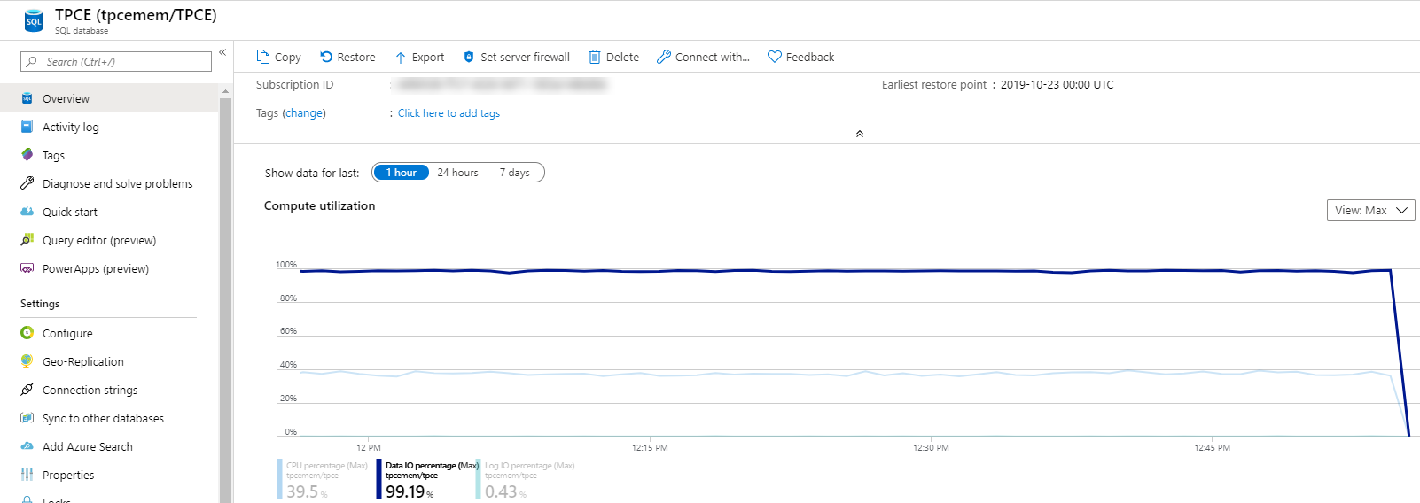
Portal: Overview, Compute utilization
Notes:
Alright so as we get near the end of this session, you might be thinking, “OK great, I can do all that”. Or, you might be thinking “Actually, no, I don’t want to do any of that”. So, I wanted to show you a few things that are available in the portal that can help at a general level.
The first thing is the overview blade in the portal. This is the most popular blade in the Azure portal. Immediately you can analyze your compute utilization.

Slide 37
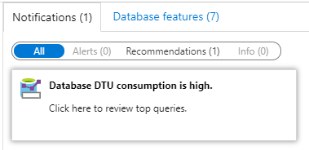
Portal: Overview Notifications
Takes you to Query Performance Insight
Notes:
If you scroll down, you’ll see something called recommendations, and if you click on it, you’ll be brought to QPI.

Slide 38
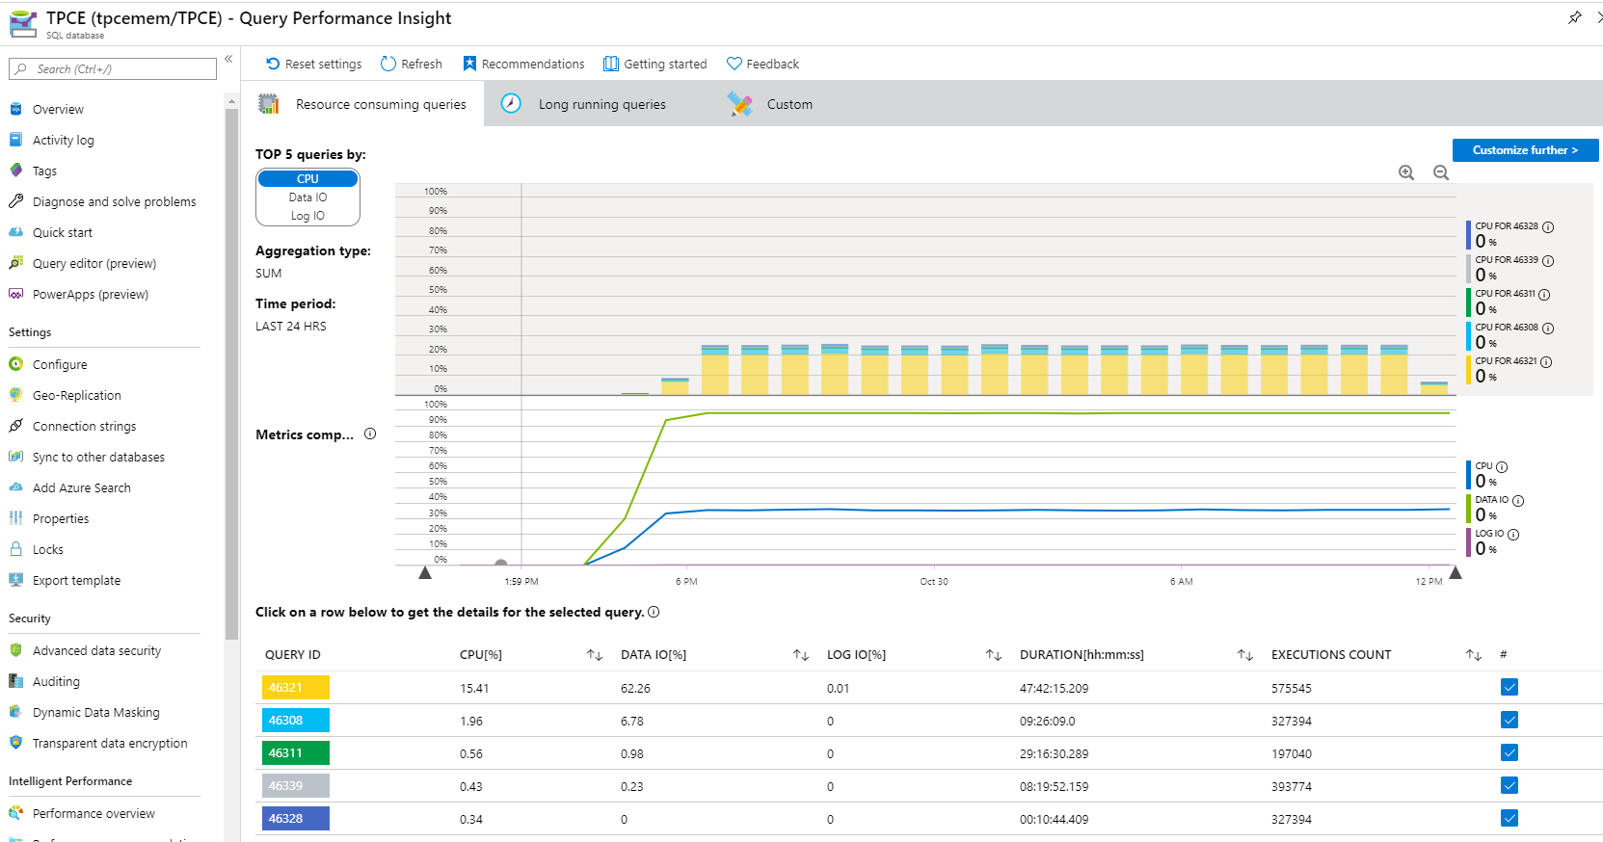
Query Performance Insight
Notes:
Form here, you can check in and see the top 5 queries by dimension of resources used, and you can click all the way through the getting the actual query text and its history.

Slide 39
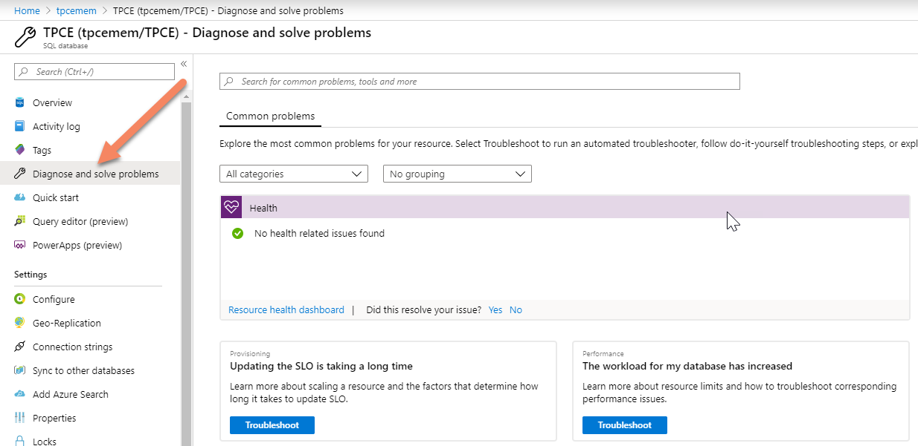
Diagnose and solve problems
Notes:
One other thing which is not talked about a lot and is ever evolving is the “Diagnose and solve problems” blade. This is based on cases we see. We’ll show you the health insights for your database, or anything else that’s going on in Azure. You might even get some insights if we predict or see anything that we think could improve your situation

Slide 40
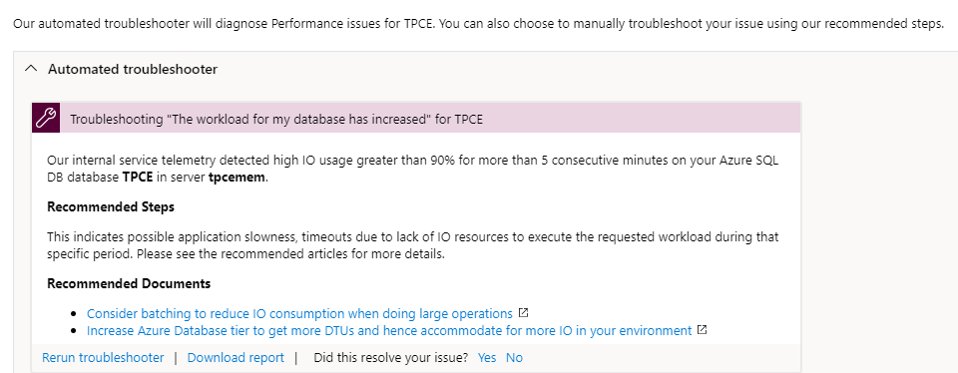
Automated Troubleshooter
Notes:
For example, and this is above and beyond query performance insights, there’s an automated troubleshooter that can give recommendations. And this again is something we’re always evolving based on the things that we notice.

Slide 41
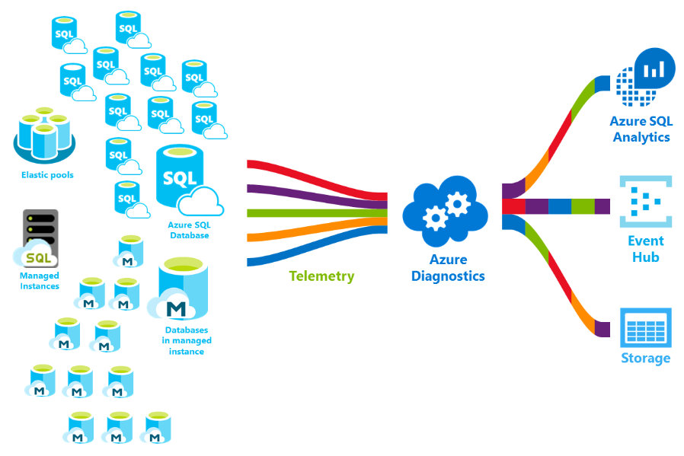
Monitoring and Analysis at Scale
Notes:
Now let’s say you’re monitoring at scale, and you have thousands on managed instances or single databases or elastic pools, etc. Azure SQL Analytics can help. You can monitor them all through one pane. We collect a lot of telemetry and you can use Azure SQL Analytics to view it, or you can take it to other places like storage or event hubs for further data driven decision-making. But with Azure SQL Analytics, we make a dashboard for you.

Slide 42
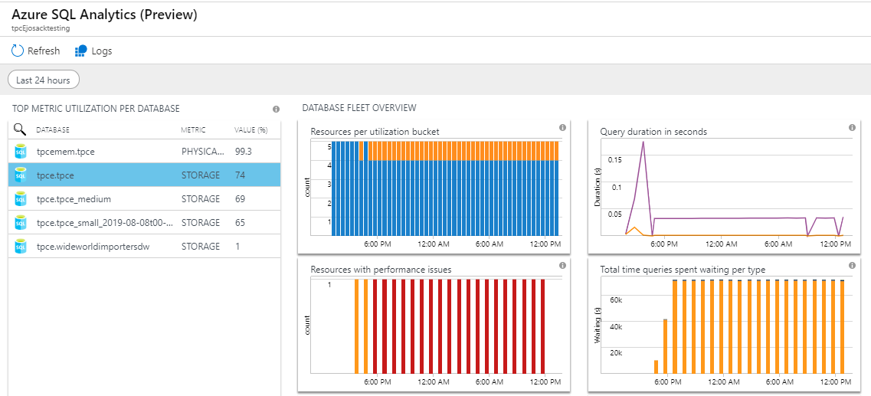
Azure SQL Analytics
Notes:
You can see a heatmap and you can click through to get to the actual top issue. This isn’t exactly included in your deployment. You have to add it through the Azure Marketplace, and then you just have to pay for the storage.

Slide 43
Intelligent Insights
Built-in intelligence that continuously monitors database usage
Uses advanced statistical models to detect disruptive events that cause poor performance
Current hour vs. last 7 days
Generates diagnostic log with intelligent assessment for disruptive events
Performs root cause analysis and provides remediation where possible for performance improvements
Notes:
Now intelligent insights can also help you. We have built a set of advanced statistical models that are based on telemetry data, and it can help. We’ll provide custom insights based on your workloads when possible.

Slide 44
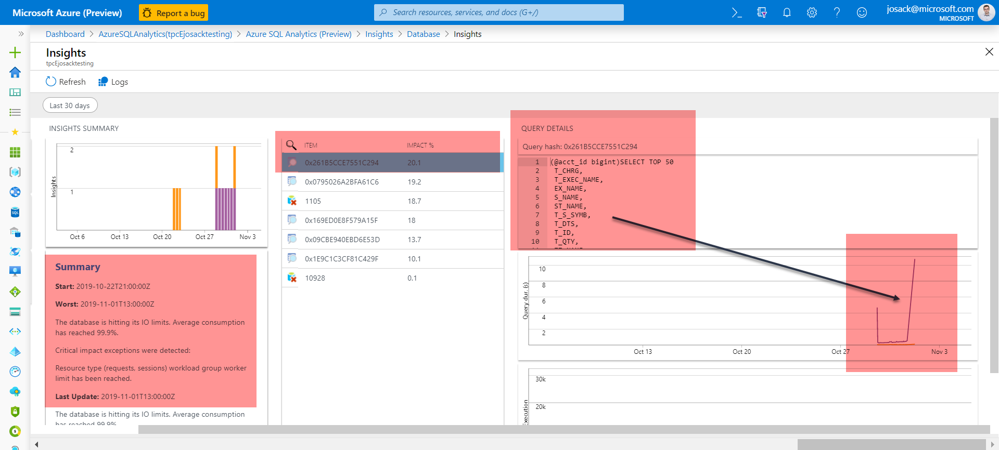
Intelligent Insights
Notes:
Now intelligent insights can also help you. We have built a set of advanced statistical models that are based on telemetry data, and it can help. We’ll provide custom insights based on your workloads when possible.
Example of insights
e.g. if you have a fleet

Slide 45
Intelligent Insights patterns
Reaching resource limits
Workload increase
Memory pressure
Locking
Increased MAXDOP
Pagelatch contention
Missing Index
New Query
Increased wait stat
Tempdb contention
DTU shortage
Plan regression
Database scoped configuration change
Slow client
Pricing tier downgrade
https://docs.microsoft.com/en-us/azure/sql-database/sql-database-intelligent-insights-troubleshoot-performance#critical-sql-errors
Notes:
These are the patterns we can automatically identify. Even if you don’t plan on using this feature, you should still check out this documentation page because it’s a great runbook containing an operational guide of what we can identify and what we recommend (https://docs.microsoft.com/en-us/azure/sql-database/sql-database-intelligent-insights-troubleshoot-performance#critical-sql-errors
).

Slide 46
Demo
Intelligent Database

Slide 47
In closing
Understand the balance of performance and by-default BCDR (governance) used in the cloud
As you’ve seen - many existing SQL Server techniques can be applied to Azure SQL Database as well
Performance tuning skills = immediate cost savings in the cloud, so it is worth the skills-investment
aka.ms/sqlworkshops & aka.ms/annalytics
Notes:
So we’ve given a pretty wide tour of the availability landscape and the performance landscape, hopefully you’ve learned something knew. But also, we hope you’re now feeling confident that your SQL Server skills are very much relevant in Azure SQL database. We’re in this time where the Hybrid DBA is more and more common, and I think you all can greatly contribute to what we’re doing here.

Slide 48
Questions?
Don’t forget to complete an online evaluation!
Azure SQL Database: Maximizing Cloud Performance and Availability
Your evaluation helps organizers build better conferences and helps speakers improve their sessions.
Thank you!
antho@microsoft.com
twitter: @AnalyticAnna

Slide 49

Speaker: Your Name Here
This should be a bio slide…
Feel free to have one, or not ;-)
You can change this up to suit your style
Feel free to REPLACE or DELETE the “your logo” images that are on slides: 1, 2, and 14
Only include the SQLafterDark slide (slide 3) for MONDAY and TUESDAY sessions; no need to include it for WEDNESDAY sessions as SQLafterDark will have already happened on TUE evening! THANKS!
If you have any questions about this template, feel free to shoot me an email: Kimberly@S QLskills.com. THANKS!

Slide 50
Reminder: Intersect with Speakers and Attendees
Tweet tips and tricks that you learn and follow tweets posted by your peers!
Follow: #SQLintersection and/or #DEVintersection
Join us – Wednesday Evening – for SQLafterDark
Doors open at 7:00 pm
Trivia game starts at 7:30 pm
Winning team receives something fun!
Raffle at the end of the night
Lots of great items to win including a seat in a five-day SQLskills Immersion Event!
The first round of drinks is sponsored by SentryOne and SQLskills
&

Slide 51
Overview
Introduction
Please review this entire sample deck and all of the notes!
Blah
Blah
Stuff
More stuff
And more stuff

Slide 52
Main Title With Subtitle
The title (28 pt) uses the blue that’s in the template (4th color)
The subtitle is 1 size smaller (24 pt) and should always uses the template light blue (5th color) from the top row of the color chooser
Text here is 20 pt
18 pt
16 pt
14 pt (but try not to have too many rows of this size)

Slide 53
Graphics And Shading
Gradient fills work really well but use your best judgment on colors
Use a black 3/4pt outlines for shapes and arrows and black image text
Use this “content” slide without the background image so it’s less cluttered
Use the slide with the background image for text-only slides

Slide 54
Slide With Code
* Code should be in this box with the light blue background (or, gray if you prefer)…
* You don’t need to use this everywhere but if you have a lot of code, this is good.
* Consolas is a good font (any fixed-width font is fine)
* Regardless, please be consistent with code examples
* Finally, the size of this box can be larger / smaller – just use your best judgement! Thanks!

Slide 55
Demo Slide Please play your entire deck to understand the animations!
All of the content on the demo slide is animated
It runs automatically – you do not need to click through it
It’s timed so that the demo bar wipes left to right and then the logo and the word Demo appear
Then, with a minor delay, the name and subtitle of the demo will appear
If you plan to discus the demo for a minute before going to the demo, you might choose to change the demo/subtitle to “on click”
Be sure to PLAY the entire deck to understand the animations!

Slide 56

Demo
Demo Title
Subtitle

Slide 57
Final Comments
You should always have a review slide that “mirrors” the Overview slide
If you want to have references that you describe in detail, then we suggest you use a:
References slide (or more than one)
Then, your review slide
Then, a Questions? / Thank You! slide at the end
Otherwise, use:
Your review slide
Then, a Questions? / Thank You! slide at the end
You can change this up to suit your style (maybe references after review) but always have a review slide and the Questions? / Thank You! slide

Slide 58
References

Slide 59
Review
Overview
Blah
Blah
Stuff
More stuff

Slide 60
Questions?
Don’t forget to complete an online evaluation!
Azure SQL Database: Maximizing Cloud Performance and Availability
Your evaluation helps organizers build better conferences and helps speakers improve their sessions.
Thank you!

Slide 61


Save the Date!
www.SQLintersection.com
2020
Week of April 6
We’re back in Orlando!
Leave the every day behind and enter a world of wonder and enchantment at the Walt Disney World® Resort. Located in the heart of the most magical place on earth, the Walt Disney World Swan and Dolphin Resort provides a truly extraordinary backdrop for our event! Beautiful tropical landscaping, tranquil waterways, and classic art and architecture work together to create a stunning landmark!

